Slide 1
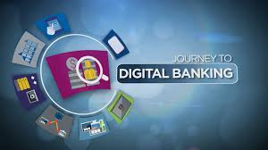

DIGITAL BANKING
[ By NAVEEN SAINI ]

Slide 2
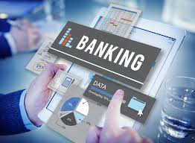
INTRODUCTION
Digital banking is the digitization (or moving online) of all the traditional banking activities and programs that historically were only available to customers when physically inside of a bank branch. This includes activities like:
Money Deposits, Withdrawals, and Transfers
Checking/Saving Account Management
Applying for Financial Products
Loan Management
Bill Pay
Account Services

Slide 3
VARIOUS PROCEDURES of DIGITAL BANKING
PART 1
. 1.Open a bank account if you don’t have one already.
2.Set up your online account.
3.Choose a secure username and password.
4. Set up your contact information .

Slide 4
PART 2
Learn your way around the portal.
Opt out of paper statements.
Use online bill pay.
Apply for lines of credit or loans through the online portal.
Check for special offers or messages in the portal.
Transfer money between accounts.
Use a mobile banking application.

Slide 5
PART 3
Avoid using online banking on public WiFi .
Stay aware of your surroundings when banking on your smartphone in public.
Monitor your accounts for any signs of fraud or theft.

Slide 6
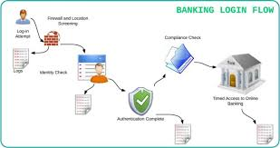
FUNCTIONING of DIGITAL BANKING
Quick Transfer .
Bill Payment .
Checking Account Information .
Multiple Transfer .

Slide 7
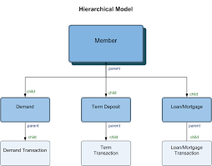
HIERARCHICAL ORDER OF THE BANKING SYSTEM
Analyst
Associate
Senior Associate
Assitant Vice President
Vice President
Senior/Executive Vice President
Executive Director
Managing Director
Regional Level CXO positions (say APAC Risk ad, EMEA Treasury Head etc )
Global CXO level positions.

Slide 8
SPECIAL FOCUS ON DIGITIZATION OF THE BANKING SYSTEM
Digital Transformation is far beyond just moving from traditional banking to a digital world. It is a vital change in how banks
and other financial institutions learn about, interact with and satisfy customers. An efficacious Digital Transformation
begins with an understanding of digital customer behavior, preferences, choices, likes, dislikes, stated as well as unstated
needs, aspirations etc.. And this transformation leads to the major changes in the organizations, from product-centric to
customer-centric view.

Slide 9

AWARENESS ABOUT THE FUNCTIONING OF BANK WITH SPECIAL REFERENCE TO DIGITAL BANKING
We should always be aware about the attacks in digital banking because :-
Attacks on digital banking is used today are based on Deceiving the user to steal login data and valid TAN’S . A method to attack signature based online banking methods is to manipulate the used software in a way .

Slide 10
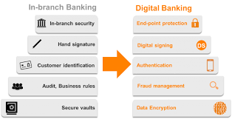

SECURITY FOR DIGITAL BANK ACCOUNT
Security of a customer’s financial information is very important,without which online banking could operate .
Financial institution have set up various security processes to reduce the risk of unauthorized online excess to a customer’s records but there is no consistence to the various approaches adopted .
The use of a secure website has been almost universally
embraced . Though password authentication is still in use .

Slide 11
THANKS

